Slide 1
Debugging an Operation
Using a Failed Proof of Correctness as a Guide
Joan Krone – Denison University
Joseph Hollingsworth – Indiana University Southeast

Slide 2
What Went Wrong?
Student implements an operation
Student creates a testing harness a small client program
Student runs the testing harness
Receives unexpected output
The operation doesn’t seem to do anything!

Slide 3
Invert
Operation Invert (Q: P_Queue); ensures Q = Reverse(#Q);
The outgoing Q equals the reverse of the incoming Q
#Q – incoming
Q – outgoing
P_Queue is a preemptable queue
Has one additional operation – Inject
Notes:
Insert

Slide 4
String Theory
Used for mathematically modeling a Queue
Γ - is the alphabet, e.g., Γ = Z
Notes:
Insert

Slide 5
String Theory
Used for mathematically modeling a Queue
Γ - is the alphabet, e.g., Γ = Z
Example strings:
α = <4,22,3,17> string of 4 integers
β = < > empty string
Notes:
Insert

Slide 6
String Theory
Used for mathematically modeling a Queue
Γ - is the alphabet, e.g., Γ = Z
Example strings:
α = <4,22,3,17> string of 4 integers
β = < > empty string
Concatenation, Length, Reverse
<-5> o α o <101> = <-5,4,22,3,17,101>
|α| = 4
Reverse(α) = <17,3,22,4>
Reverse(α o <101>) = <101,17,3,22,4>
Notes:
Insert

Slide 7
Testing Harness for Invert
Begin q: P_Queue; Enqueue(3, q); Enqueue(2, q); Enqueue(1, q); Writeln("q before Invert = ", q); Invert(q); Writeln("q after Invert = ", q); end;
Output:
q before Invert = <3,2,1>
q after Invert = <3,2,1>

Slide 8
How to Debug? I Could Try …
Using one of those genetic algorithms to make random mutations to my code …

Slide 9
Or Maybe I Should …
Do that proof of correctness thingy that my professor showed us.

Slide 10
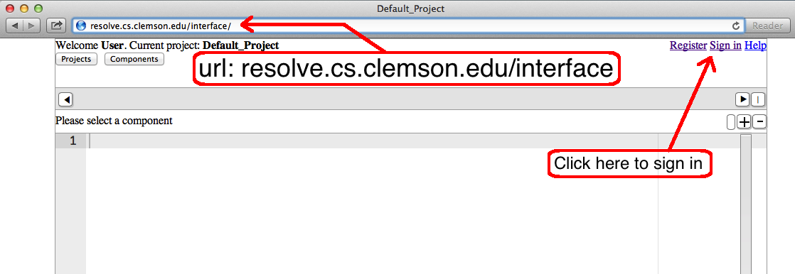
Accessing the RESOLVE Web Interface
Notes:
At this point we switch to the Resolve Web Interface and show them defective Invert (like screen shot below)
Then generate VCs, look at each VC and explain why it is there, e.g., precondition on Dequeue
Then run “verify” to find out which VC can’t be proved
Show why that VC be proved, and notice that the substitution shows that the Goal: (<E'> o Reverse(Q')) = Reverse(Q) reduces (through substitution) to <E'> o Reverse(Q') = Reverse(Q') o <E'>
Which means the items are being put back on the wrong end of the queue with the Inject.

Slide 11
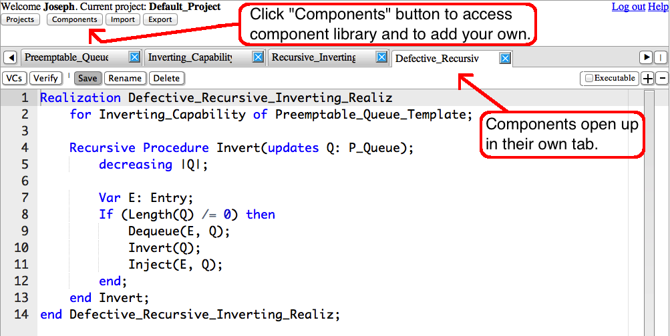
Accessing Components
Notes:
At this point we switch to the Resolve Web Interface and show them defective Invert (like screen shot below)
Then generate VCs, look at each VC and explain why it is there, e.g., precondition on Dequeue
Then run “verify” to find out which VC can’t be proved
Show why that VC be proved, and notice that the substitution shows that the Goal: (<E'> o Reverse(Q')) = Reverse(Q) reduces (through substitution) to <E'> o Reverse(Q') = Reverse(Q') o <E'>
Which means the items are being put back on the wrong end of the queue with the Inject.

